Slide 1
U.S. Presidential Elections, 1976-2020
Introduction to Data Science
Saiida Webb

Slide 2
Table of Contents
Introduction of Dataset
Objective of Project
Method, Cleaning
Storytelling, Visualization
Conclusion

Slide 3
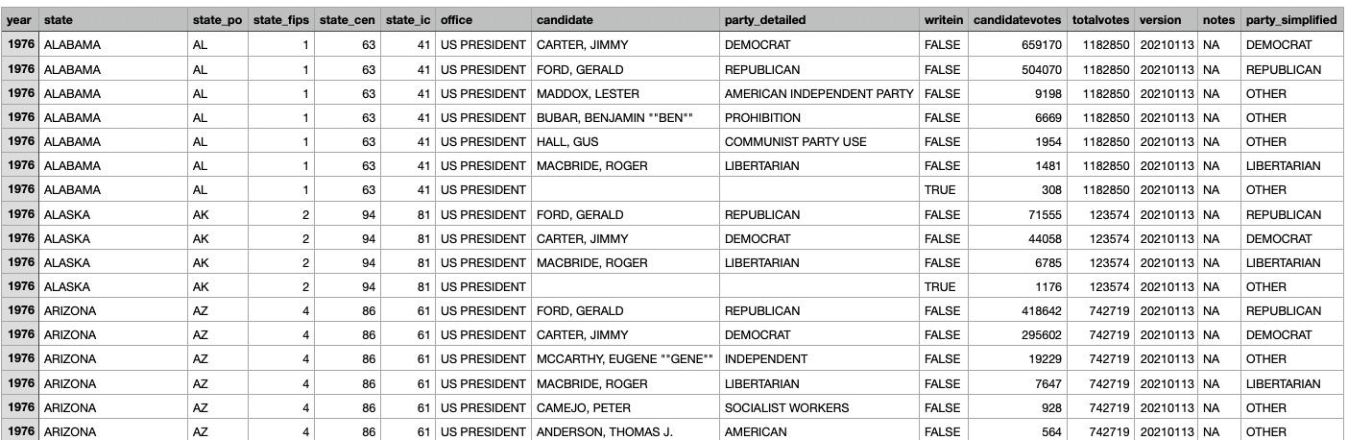
About the Data
Kaggle, “US Elections Data Set (1976-2020)
States, state identification, year, candidate information, party information, voting totals
Amount of unique values, column names and data types
Shape: 4287 rows, 15 columns
Head and tail
Alphabetical
Range of years = 44
12 cycles

Slide 4
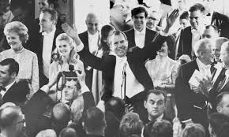
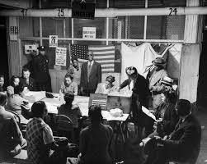
First Glance Goals
State vs. Party
State vs. Voter Turnout
Total votes, candidate votes
Candidate vs. State
Votes vs. Candidate

Slide 5
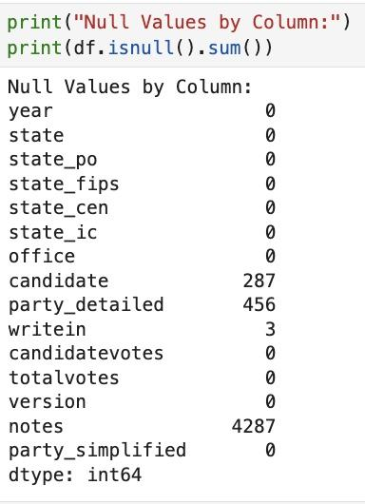
Cleansing the Data
Missing Values
Categorical Data
Numerical Data
‘state’, ‘state_po’, ‘office’, ‘candidate’, ‘party_detailed’, ‘writein’, ‘party_simplified’, ‘notes’
‘year, ‘state_fips’, ‘state_cen’, ‘state_ic’, ‘candidatevotes’, ‘totalvotes’, ‘version’
Consider relevance
Impact on the data
Replace with filler
‘Unknown’
‘Non-Applicable’
Mode
When to drop columns
Too high or too low
Replace with filler
Median
Mean

Slide 6
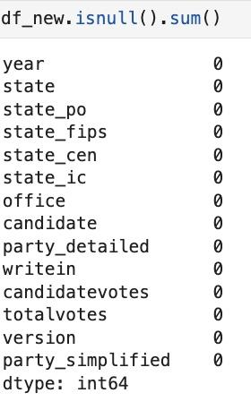
Cleansing the Data (cont.)
Replaced
‘Candidate’ : Unknown
‘Party_detailed’ : Non-Applicable
Why?
Dropped
‘Notes’ (100%)
‘Writein’ subset (0.07%)
** No missing values in numerical columns

Slide 7
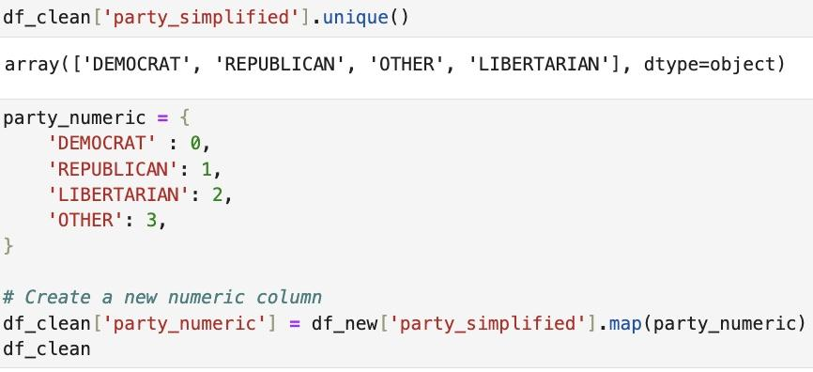
Added Columns
Party_Numeric
Vote_Percentage

Slide 8
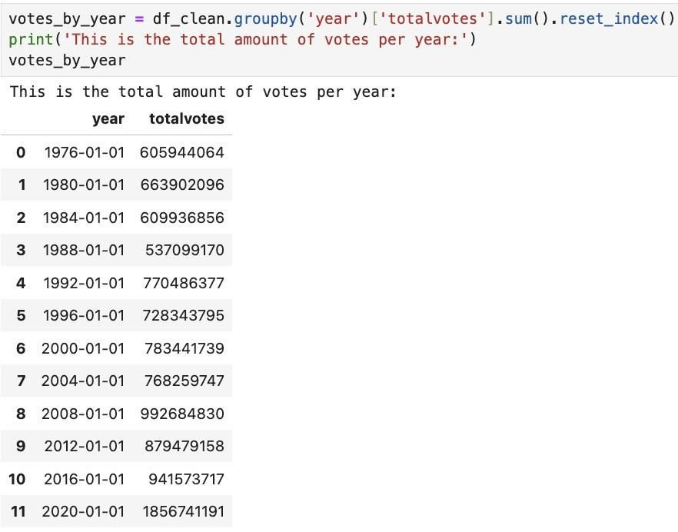
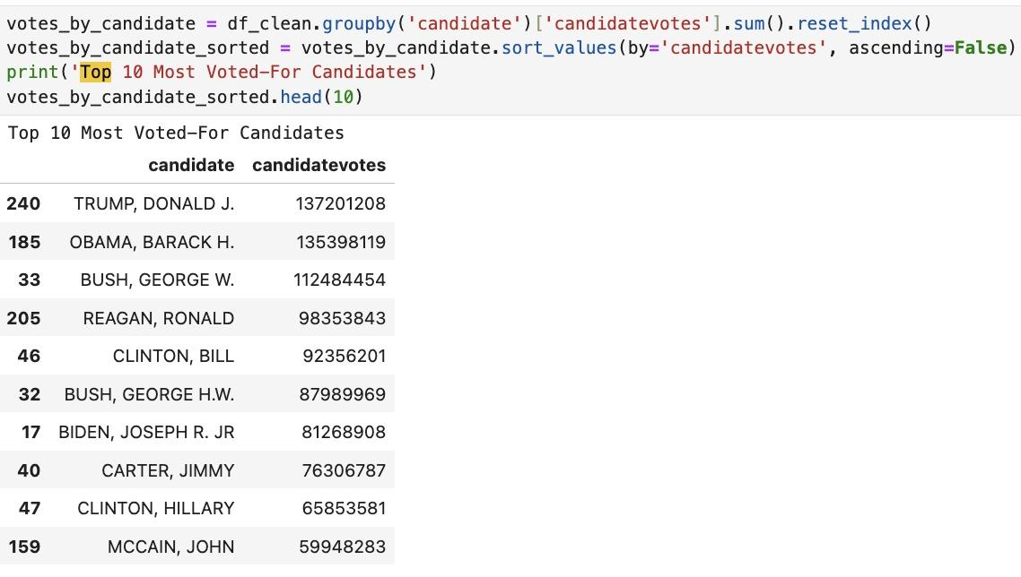
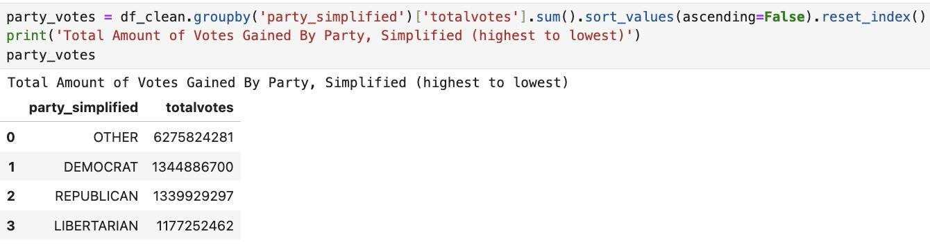
Analysis and Categorizations
Votes Over Time
Votes By Candidate
Votes By Party

Slide 9
Visualizations
Top 4

Slide 10
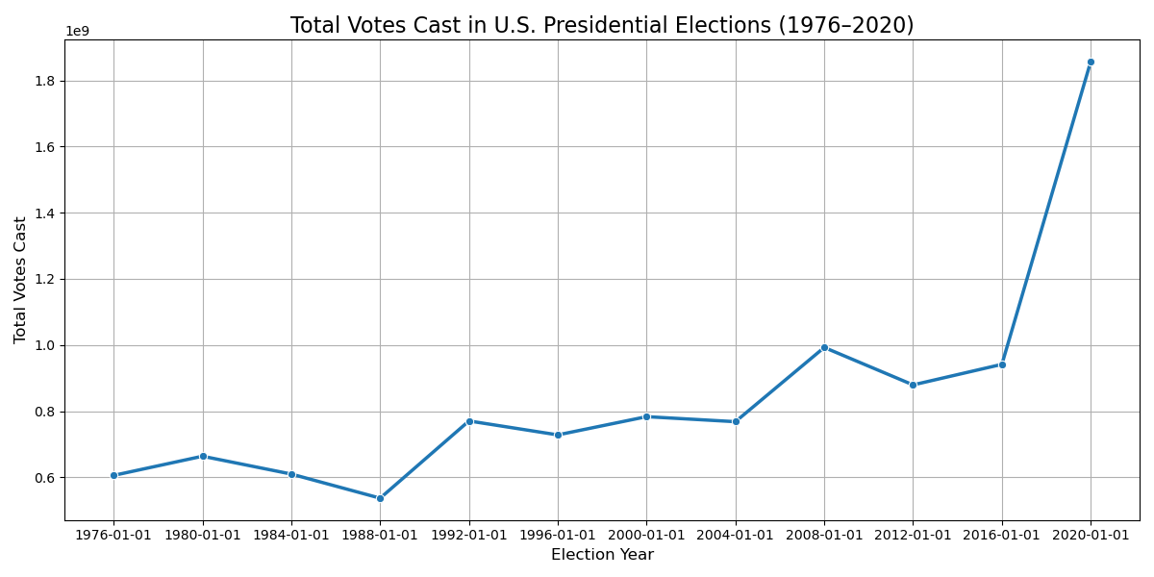
Votes Over Time

Slide 11
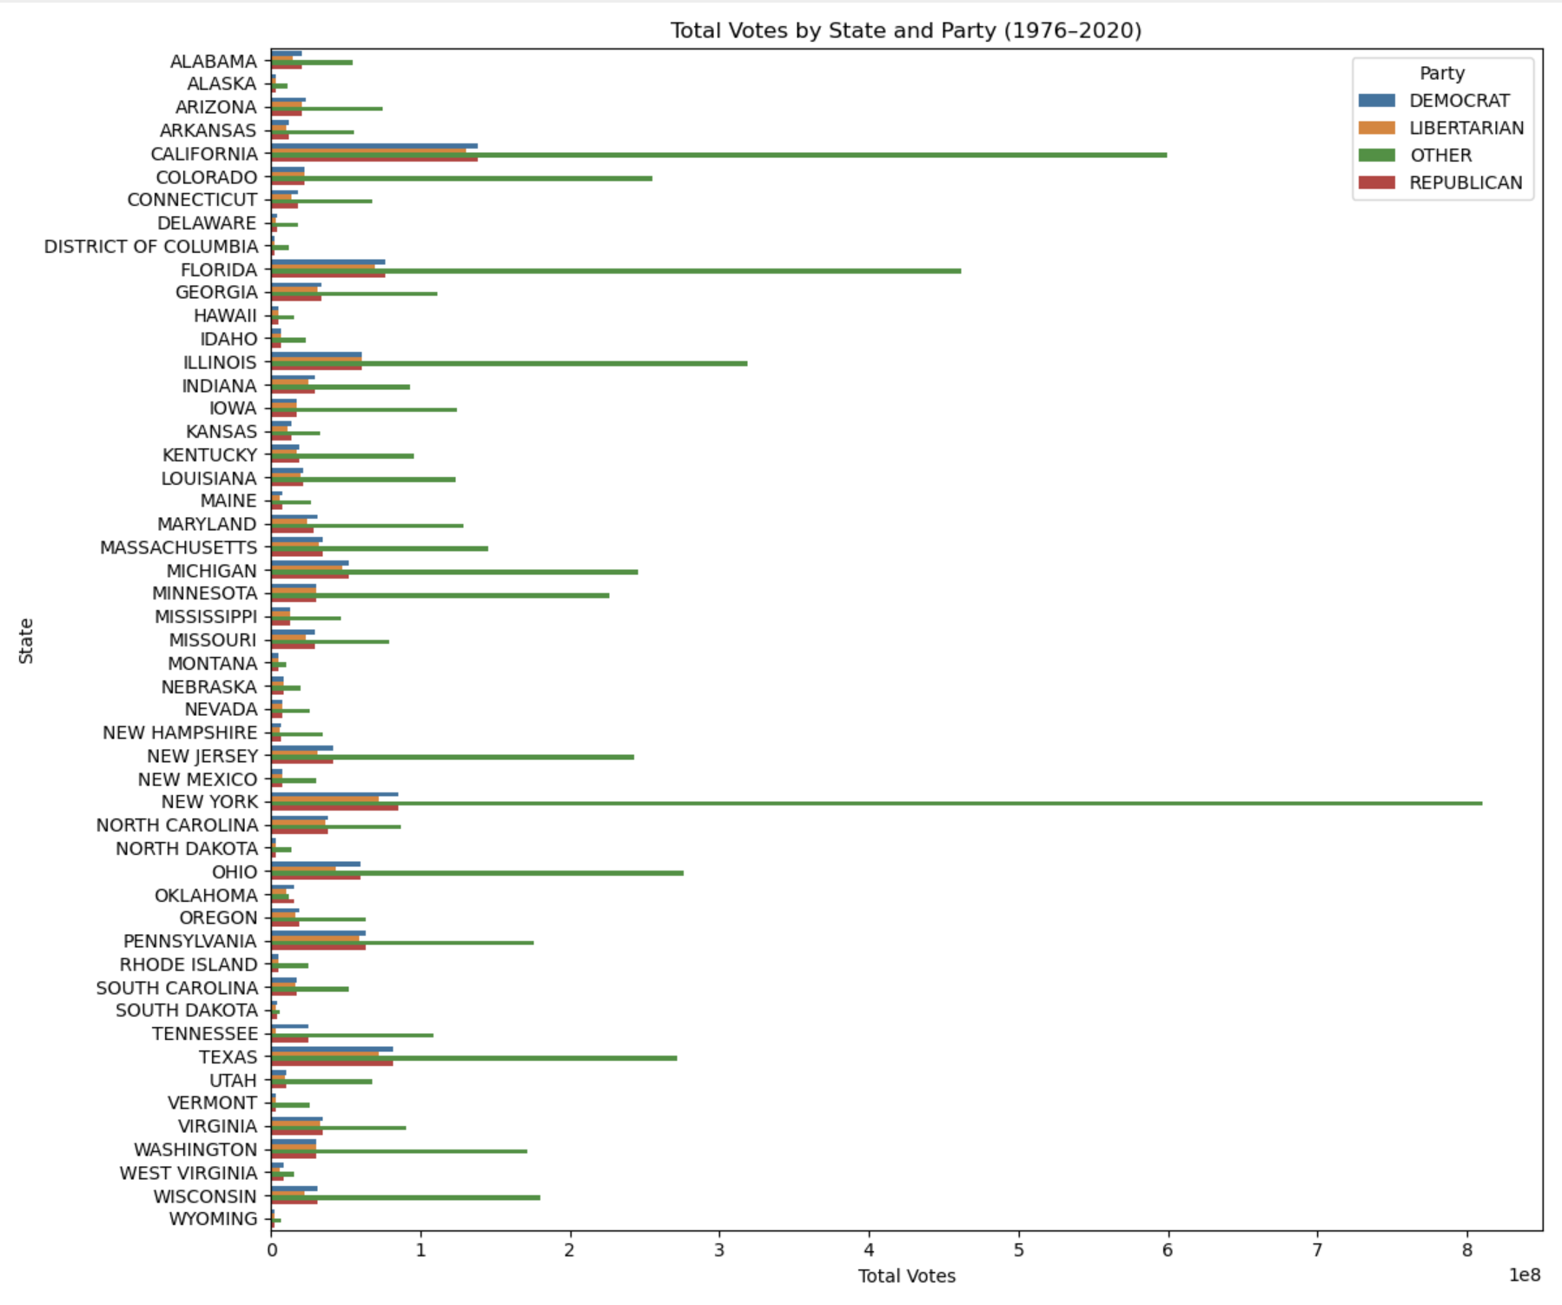
Votes, State, Party

Slide 12
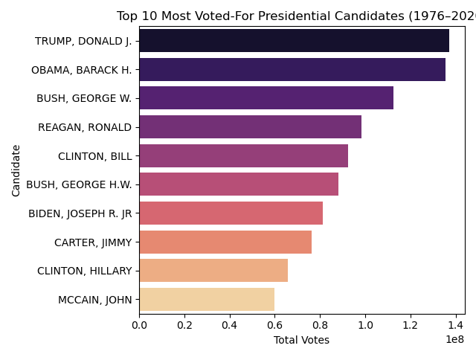
Votes, Candidate

Slide 13
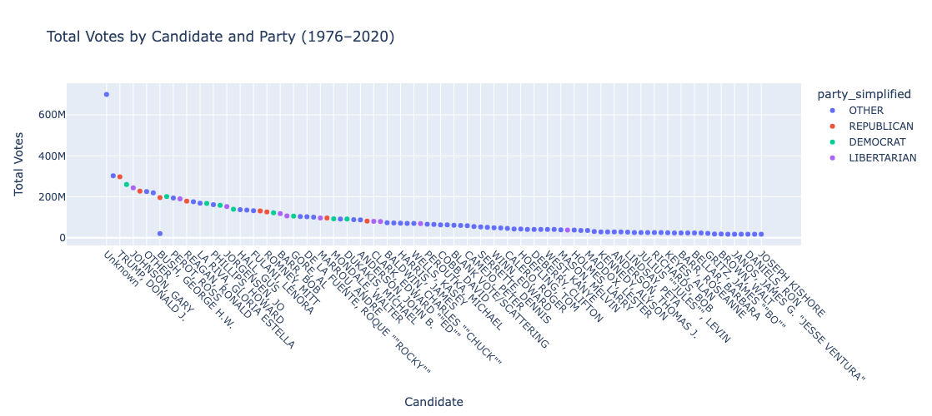
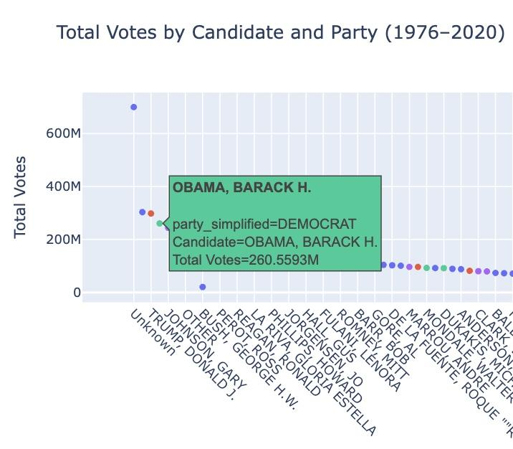
Votes, Party, Candidate

Slide 14
Conclusions
Trends and Findings
This project analyzed U.S. Presidential elections from 1976–2020 using a dataset covering all 50 states and D.C. Categorical data (like party and candidate) proved more valuable than numerical identifiers for visualizations and analysis. Key findings include:
Democrats narrowly led in total votes over Republicans (by 0.1%).
Donald Trump received the most votes, likely due to expanded access during the 2020 pandemic.
Larger states like California and Texas cast the most votes, reflecting their population size and electoral influence.

Slide 15
Thank You!

